Slide 1
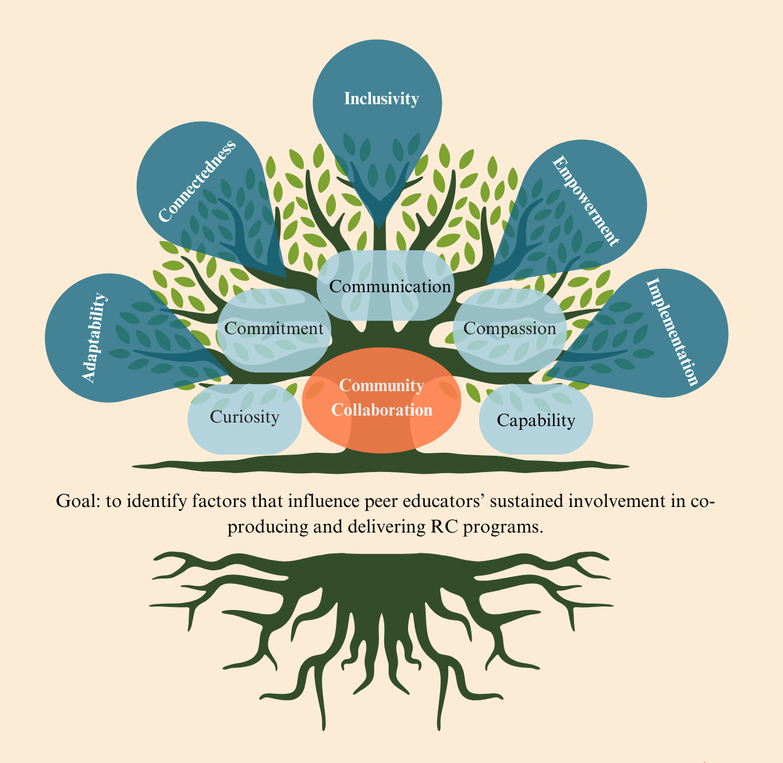


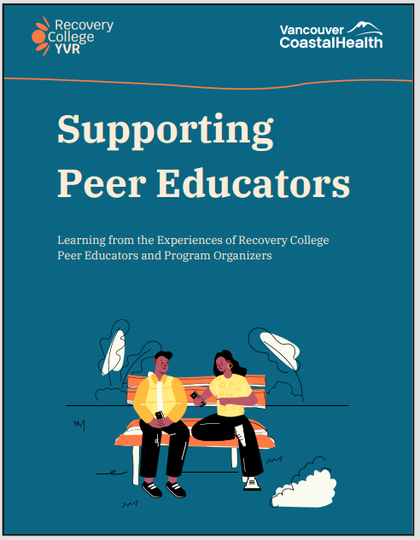
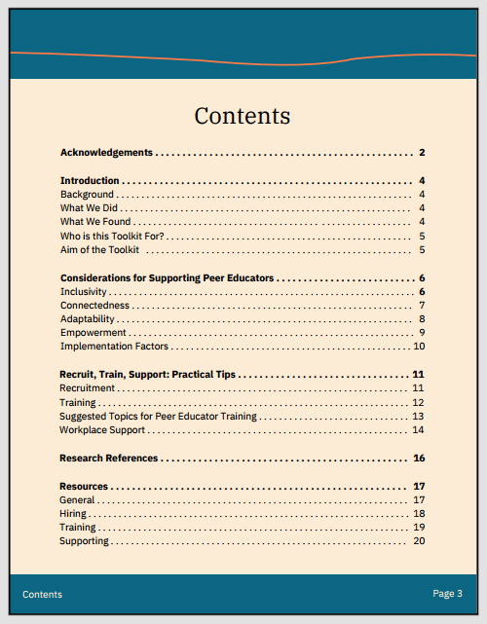
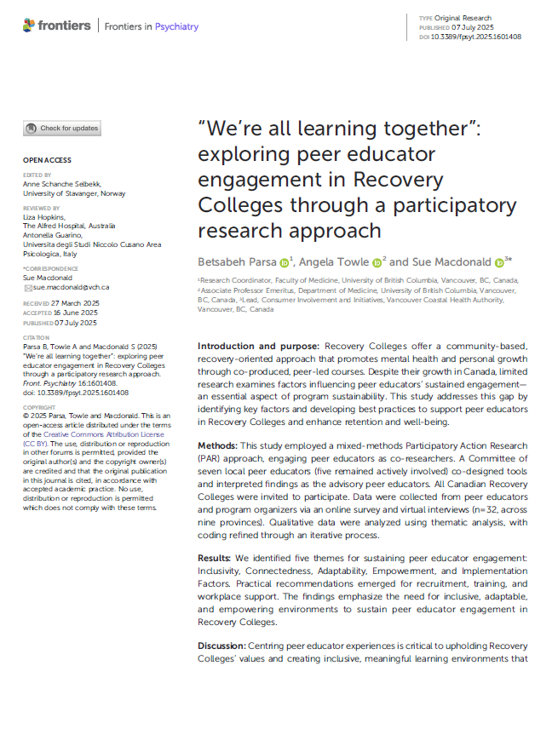




Peers at the Heart of Recovery College Research Learning From the Experiences of Recovery College Peer Educators and Program Organizers to Inform the Implementation of a Transformative Model of Mental Health and Substance Use Care at Vancouver Coastal Health Contributors (in alphabetic order): Donna Dykeman, Marilyn Galati, Sue Macdonald, Betsabeh Parsa, Mailis Valenius, Andrea Winterbottom, Soroush Zonuzi
Introduction
Results
Summary of Actionable Recommendations
Recovery College is a global movement promoting recovery, learning, and peer-led education.
Recovery College YVR is Vancouver’s local initiative.
In 2022, we began a research project to support the development of our college.
We identified a gap in literature on the peer educator experience in Canada.
32 peer educators and program organizers participated (20 surveys, 12 interviews)
Five key themes emerged as essential to sustaining peer educator engagement in Recovery Colleges: Inclusivity, Connectedness, Adaptability, Empowerment, and Implementation Factors.
Findings emphasize the need for inclusive, adaptable, and empowering environments.
Practical recommendations were developed for improving recruitment, training, and workplace support.
Theme | Recruitment | Training | Workplace Support
Inclusivity | Promote diverse outreach and equitable access to attract underrepresented peer educators. | Provide materials in multiple formats for accessibility (e.g., audio, visual, translations). | Rotate leadership roles to foster equity.
Connectedness | Build local and national networks for sharing resources. | Train peer educators in team-building and communication skills through group training sessions. | Create peer support groups and promote collaboration.
Adaptability | Select peer educators open to uncertainty and responsive to community needs. | Train on flexible facilitation and adult learning styles. | Encourage "failing forward" as part of growth.
Empowerment | Ensure peer educators have a clear personal recovery pathway and are ready to facilitate. | Offer practical and reflective training opportunities. | Provide resources to prevent burnout and encourage growth.
Implementation Factors | Standardize payment and roles to reduce power imbalances. | Train peer educators on operational and facilitation tasks. | Secure funding to support program operations.
“ This model puts everybody on a level playing field. It looks at people outside of their symptoms...so much of what’s offered in the Western supports around mental health is a medical model and very deficit-based programming. And this is the opposite of that.
A Peer Educator
Project goals
Understand barriers and facilitators for peer educators’ involvement in Recovery College programs.
Learn how to better support peer educators in their roles at Recovery College YVR
Discussion & Conclusion
Five central themes emerged as pillars for supporting peer educators.
The study generated actionable strategies and a practical toolkit to enhance peer educator engagement through improved recruitment, training, and workplace support.
A participatory action research approach enriched the findings and underscored the value of inclusive, collaborative methods in mental health research.
Methods
Mixed-methods study using a Participatory Action Research approach. Peer educators engaged in all stages of the project.
Data Collection: Online survey and Virtual interviews
Contacted 29+ Recovery Colleges across Canada.
Knowledge Translation
Goal: Identify what supports or challenges peer educators’ participation in Recovery College YVR and explore ways to better support them in their roles.
Community Toolkit:
Peer-reviewed Journal Article
…. “One of the things that's missed oftentimes is that someone who is bringing their lived experience into a space and has to work from that standpoint doesn't get to turn it off at the end of the day. Whereas a lot of other roles do, and I don't think there's an appreciation for the weight of what that is….
A Program Organizer
Rooted in collaborative values, five themes are interconnected, like branches of a tree.
This study was funded in part by a grant from the Vancouver Coastal Health Research Institute (Vancouver, British Columbia, CA). .
We wish to thank the Recovery College peer educators and program organizers who participated in the study for their openness to sharing insights about their experiences.

